Slide 1
Welcome to Kits for Kids

Slide 2
Kits for Kids
Objective
Students will be able to define energy efficiency.
Students will be able to explain why energy-efficient devices are important.
Students will commit to installing the provided energy-efficient items at home.
Agenda
5 min Energy Activity Warm Up: Energy Use and Production
5 min Energy Efficiency Introduction
10 min Fuzzy’s Fun Zone: Energy Saving Scavenger Hunt
5 min Energy Activity Cool Down: Energy Efficiency
5 min Commitment Form and Kit Handout

Slide 3
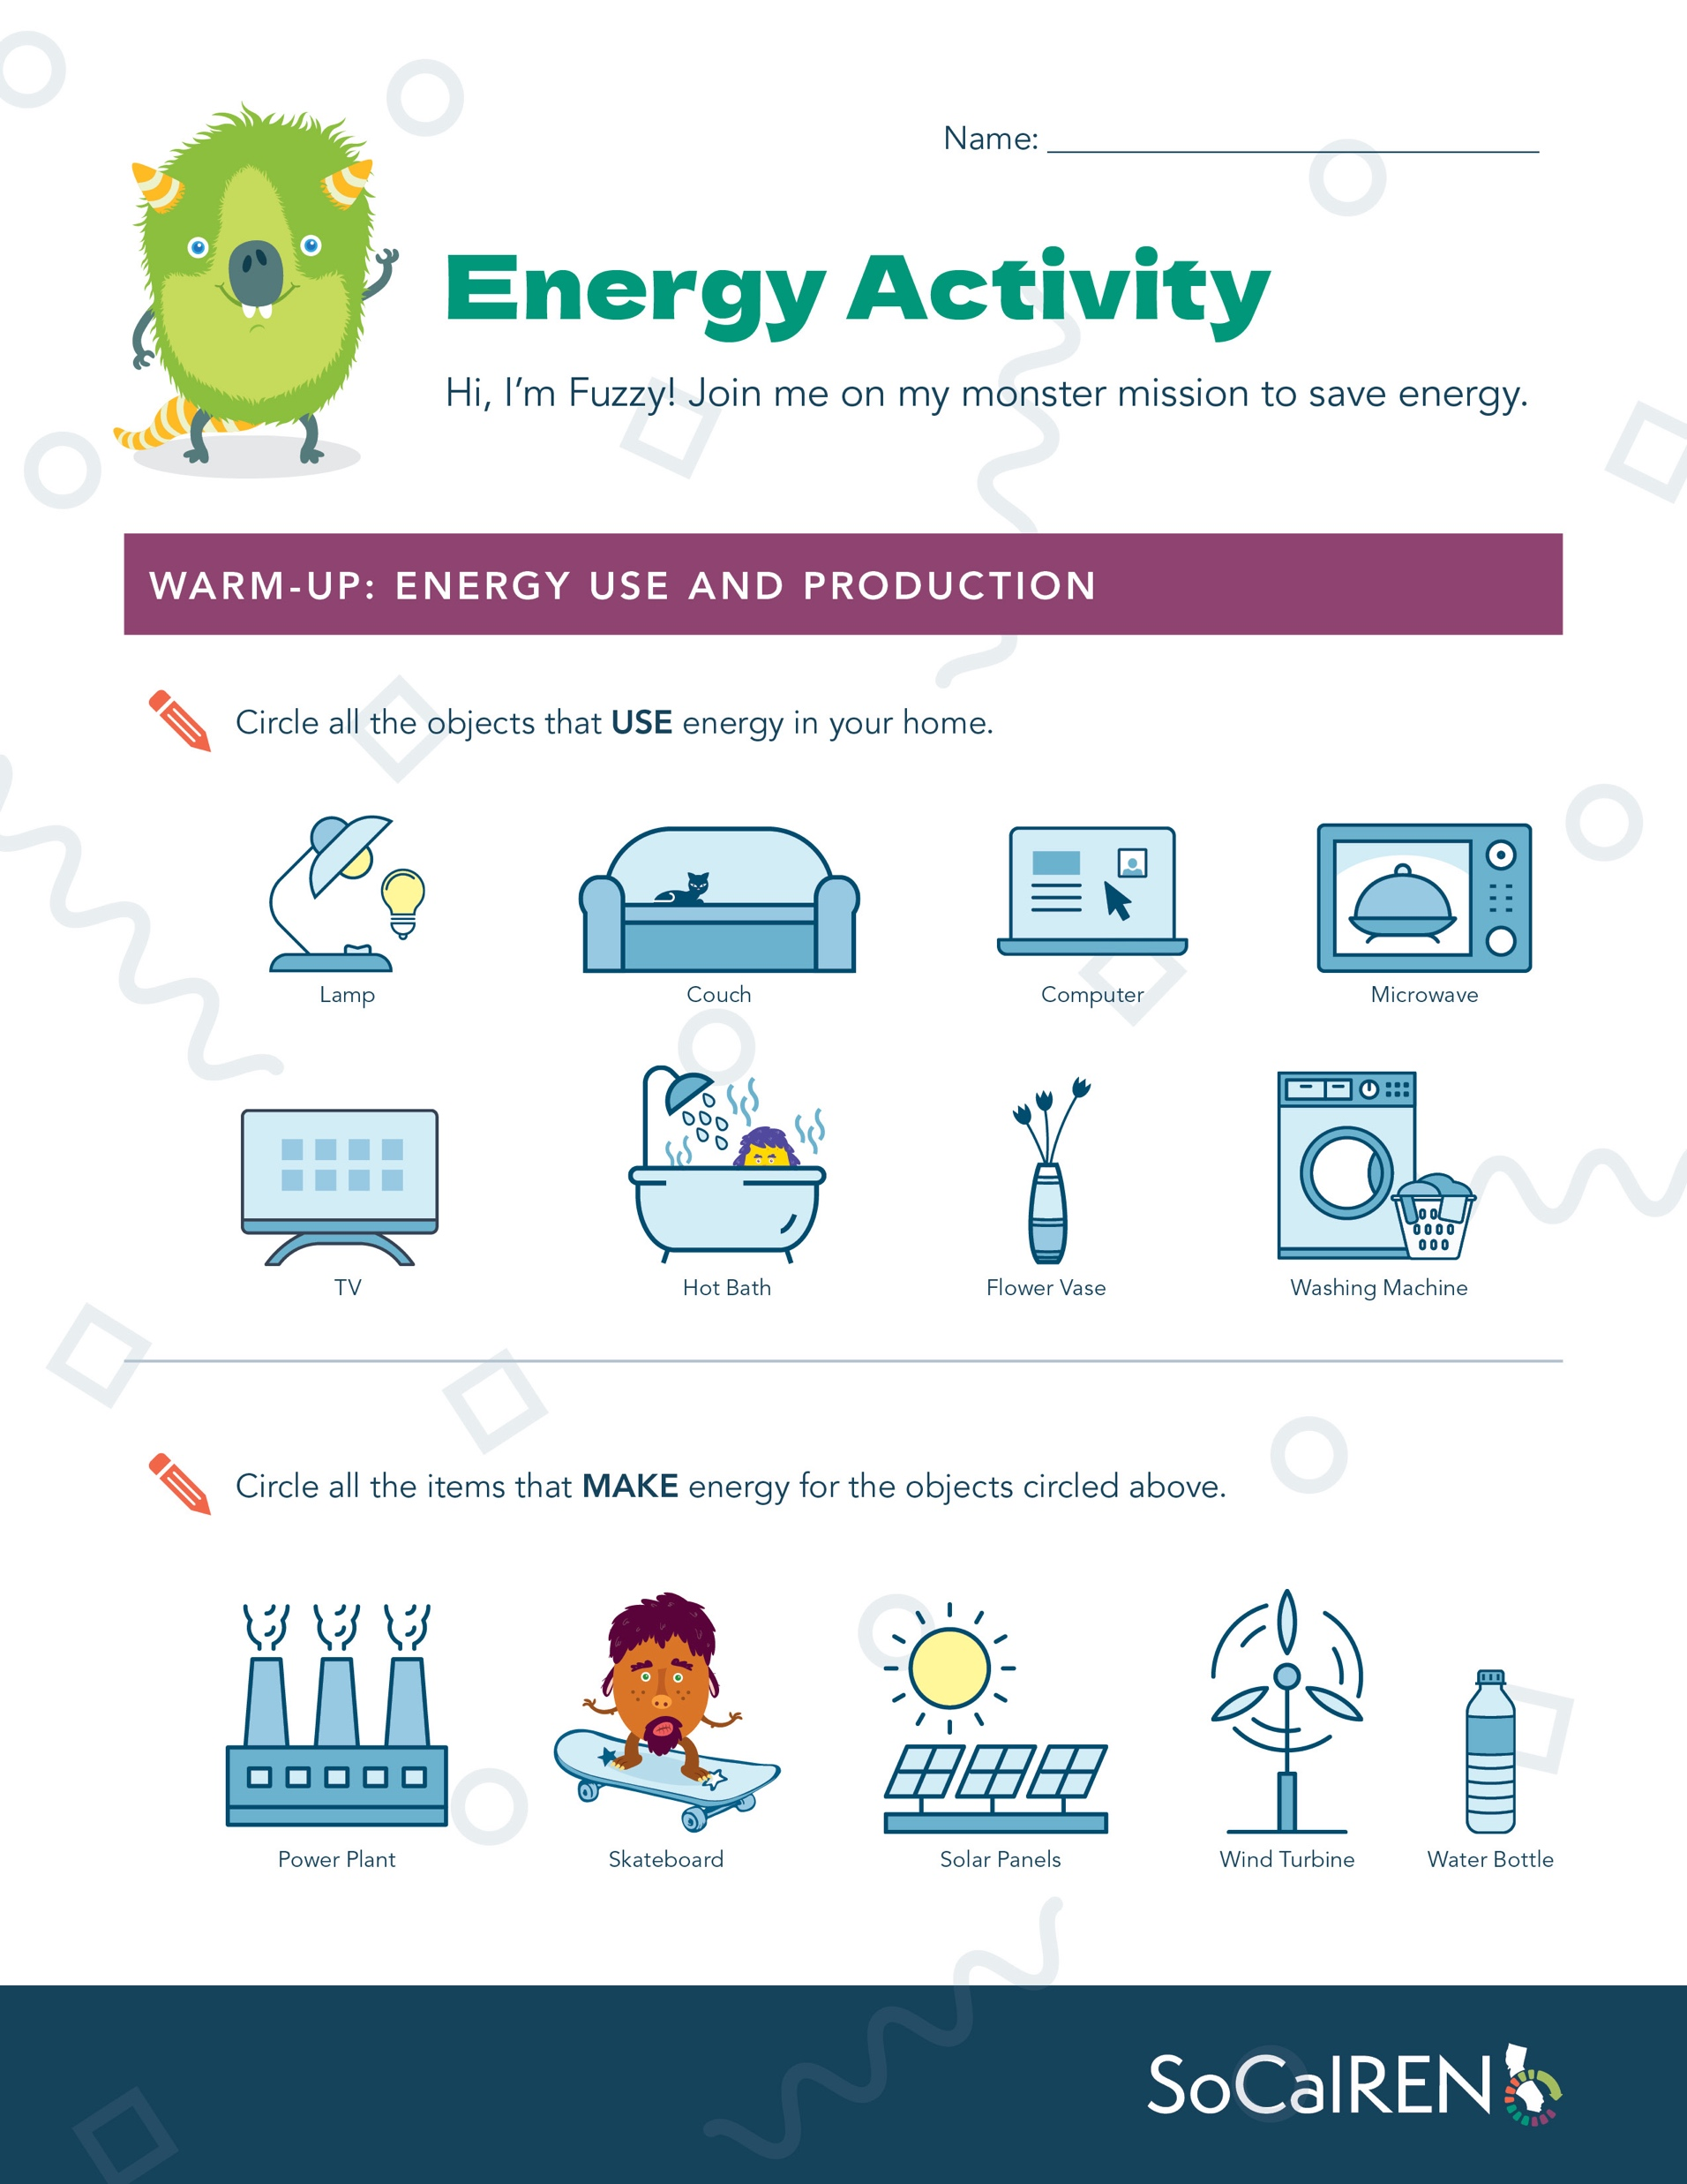
Energy Activity Warm-Up:
Energy Use and Production
Energy is needed to make things work!
Page 1: Complete Energy Activity.
Circle all the objects that USE energy in your home.
Circle all the items that MAKE energy for those objects.

Slide 4
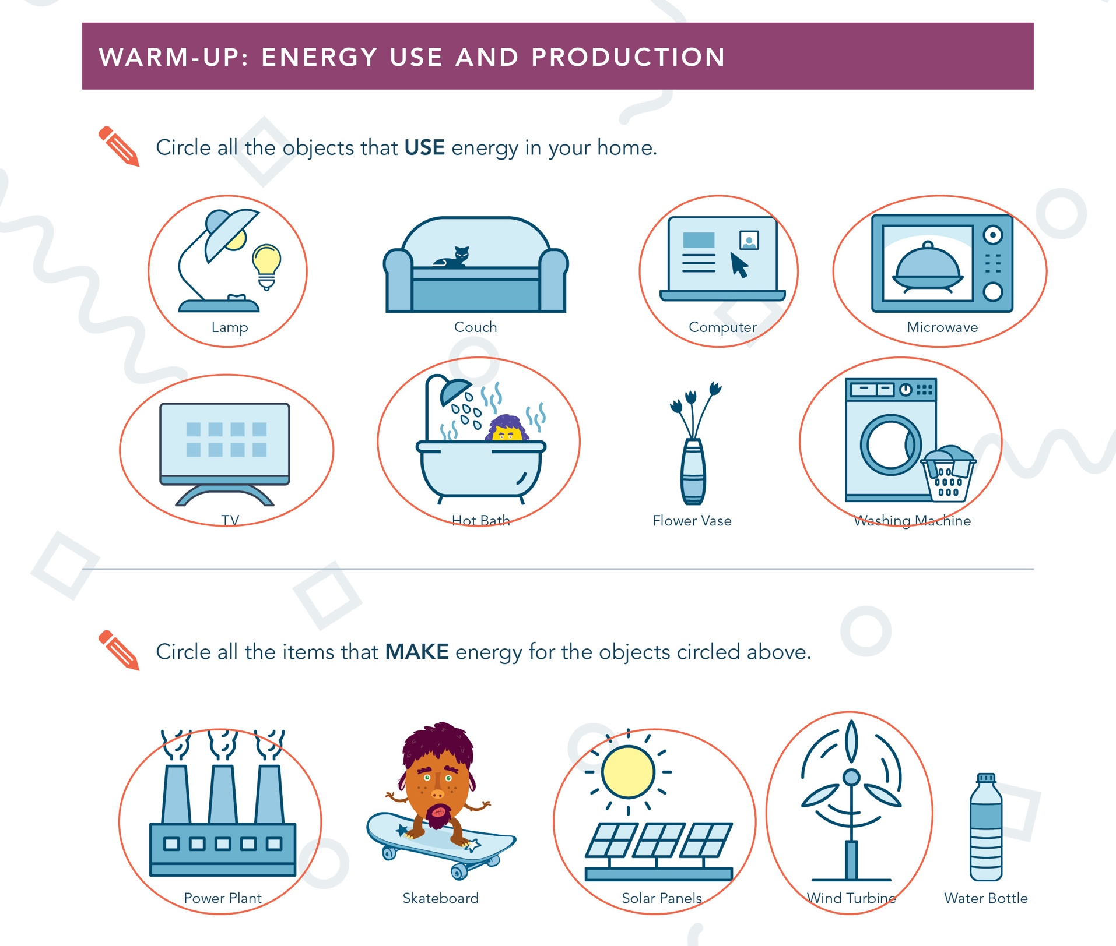
Energy Activity Answers

Slide 5
Energy Efficiency
Introduction
Energy is needed to make things work!
It is hard to produce energy. Sometimes, doing so can produce gases that are bad for the environment.
When we use less energy, we don’t need to produce as much energy. This is better for the environment.

Slide 6
Fuzzy’s Fun Zone
Energy-Saving Scavenger Hunt
Show off your energy-saving skills with Fuzzy and his crew of monsters by finding all the ways to save energy in his house.
Open the game at energymonsters.fun.
Follow the instructions to install all the energy-efficient items.
Make sure you read the fun facts of how each energy-efficient item helps save energy.

Slide 7
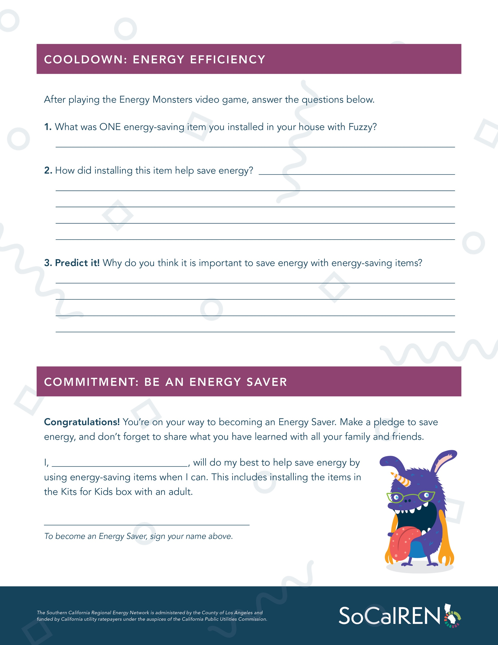
Energy Activity Cooldown:
Energy Efficiency
Energy efficiency means using less energy to do the same thing—that is, getting rid of energy waste.
Page 2: Answer the three questions in the top section.
Think about what you did in the Energy Monsters game to answer the questions.
Items you installed with Fuzzy
Showerhead
Faucet Aerator
LED Light Bulb

Slide 8
Commitment: Be an Energy Saver
Congratulations! You’re on your way to becoming an Energy Saver. Make a pledge to save energy, and don’t forget to share what you have learned with all your family and friends.
I, _______________________________, will do my best to help save energy by using energy-saving items when I can. This includes installing the items in the Kits for Kids box with an adult.
X _______________________________
To become an Energy Saver, sign your name above.

